Slide 1

Between A Rock and A Hard Place
1:21 – 30
Week 33
26 October 2022

Slide 2

Philippians chapter overview
Paul begins this epistle with his customary salutation followed by an expression of thanksgiving and prayer. He shares that the church at Philippi had been a source of great joy to him by virtue of their fellowship with him in the proclamation of the gospel (1-5).
Confident that God will complete the work He began in the Philippian Church, Paul prays that their spiritual growth will continue (6-11).

Slide 3
Philippians chapter overview
Additionally, Paul says that his circumstances at Rome have actually been for the furtherance of the gospel, despite imprisonment and opposition by false brethren. He is confident that everything will turn out all right, and that he will even come to them again (12-19).
However, it is not without mixed emotions that Paul is torn between a desire to be with Christ and a realization that to remain in the flesh is more needful for them (20-26).

Slide 4
Philippians chapter overview
Paul’s desire is that whether absent from or present with them, he may hear they are conducting themselves worthy of the gospel, by standing fast in one spirit and one mind for the gospel and by not allowing themselves to be intimidated by any adversaries (27-28).
Finally, Paul encourages them to take comfort in knowing that, like himself, they have been granted the honor not only to believe in Christ, but also to suffer for His sake (29-30).

Slide 5
Philippians 1:21 – 30
This is about head-scratching predicaments that don’t fit into a simple “this is right and that’s wrong” approach. This is about those gray areas that can’t be reduced to convenient black-and-white options. By “dilemmas” I mean decisions for which there are pros and cons on either side. No matter which box you check or which path you take, something will be lost and something will be gained.
In Philippians 1:21-30, we encounter an emotional dilemma in Paul’s mind. It was prompted by his absolute love for and devotion to Christ. On the one hand, in his heart of hearts, he longed to be with Christ personally—to walk and talk with Him in paradise. What a great blessing to be with the Lord!

Slide 6

“Between A Rock and A Hard Place”

Slide 7
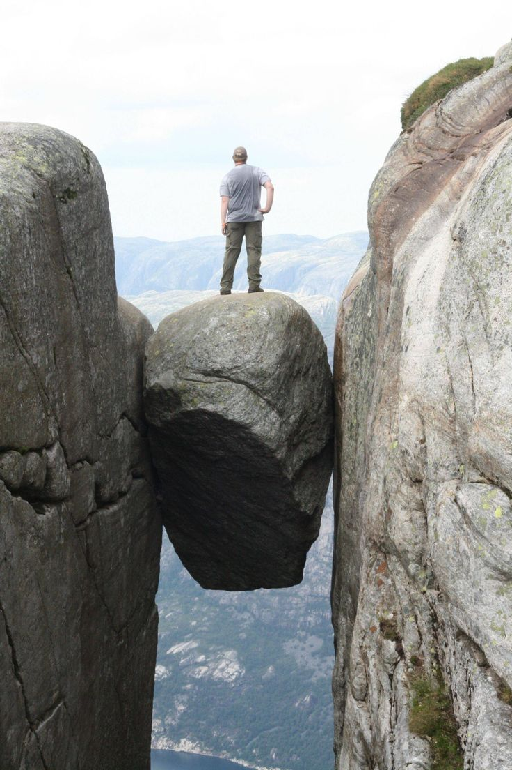

Slide 8
Philippians 1:21 – 30
Have you ever waffled between two different—and reasonable—opinions, unable to decide which one to hold? Or thrown your hands up in frustration because you couldn’t land on a conclusive decision between two equally favorable options? Or driven your friends and family mad seeking their advice about which course of action to take? Or wrung your hands over a decision, worried that you were about to make the wrong one?
Welcome to the club. We’ve all been there. All includes everyone from Adam to you and me; humans have been finding themselves repeatedly “stuck between a rock and a hard place,” facing difficult dilemmas. This is not about choosing between what is morally good or evil. There should be no wrestling with that.

Slide 9
Philippians 1:21 – 30
But on the other hand, Paul deeply longed to labor for Christ, to invite others into a relationship with Him, and to represent Him as an ambassador of grace to a needy world.
Obviously, Paul couldn’t have both. But which did he desire more? More importantly, how did the dilemma draw him closer to Christ? And how did its resolution result in encouragement both for him and for us?

Slide 10
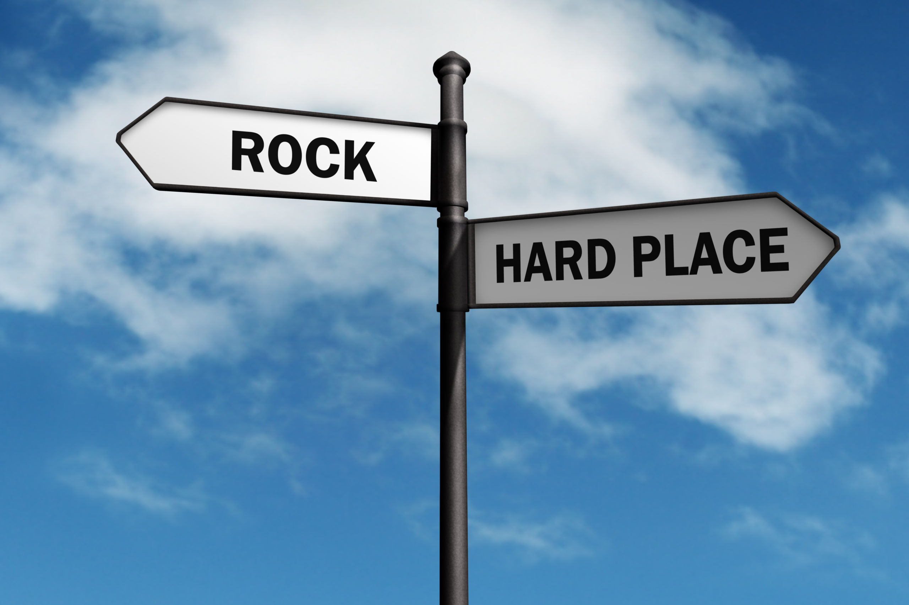

Slide 11
Philippians 1:21 – 26
²¹For to me, to live is Christ, and to die is gain. ²²But if I live on in the flesh, this will mean fruit from my labor; yet what I shall choose I cannot tell. ²³For I am hard-pressed between the two, having a desire to depart and be with Christ, which is far better. ²⁴Nevertheless to remain in the flesh is more needful for you. ²⁵And being confident of this, I know that I shall remain and continue with you all for your progress and joy of faith, ²⁶that your rejoicing for me may be more abundant in Jesus Christ by my coming to you again.

Slide 12
Philippians 1:21 – 26
Paul’s joyful attitude in the midst of unfavorable conditions was a direct result of placing Christ at the center of his life (1:12-20). In fact, because his whole being revolved around Christ, Paul could honestly say that “whether by life or by death” Christ would be exalted through him (1:20). He sums up this radically Christ-focused approach to life in one of the most profound but puzzling statements in the letter > “For to me, to live is Christ and to die is gain” (1:21).
Paul’s real dilemma begins in 1:22 with the word “But.” He longed to be with the Lord in glory . . . but he also wanted to live on in the flesh so he could continue to bear fruit in ministry.

Slide 13
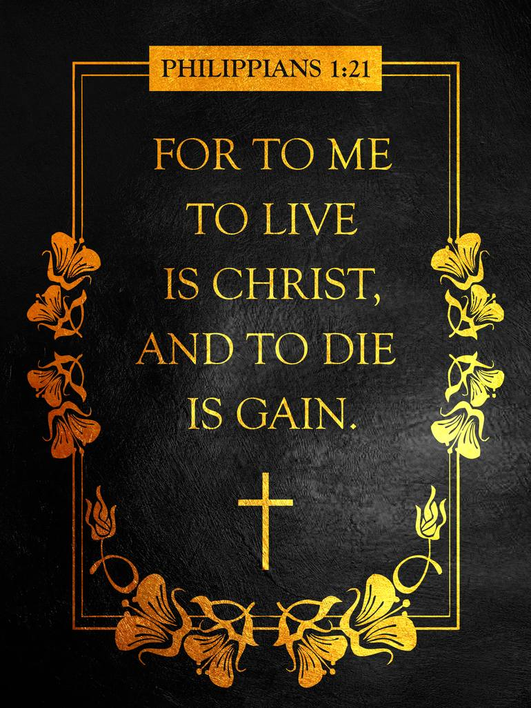

Slide 14
Philippians 1:21 – 26
Wedged between a rock and a hard place, Paul didn’t know which to choose—not that he really had a say in the matter. Paul wasn’t contemplating suicide. He wasn’t talking about taking his life into his own hands. He was facing a hearing before Caesar’s court that could end up with his beheading—as it actually did about five years later.
Paul was at the mercy of the court at the human level, and at the mercy of the sovereign God at the divine level. Nevertheless, as Paul contemplated either outcome—freedom or martyrdom—he thought, “If I had a pick, I’m not sure which I’d choose!”

Slide 15
Philippians 1:21 – 26
As in all dilemmas, both alternatives had benefits and liabilities. Paul ponders these in 1:22-24. If Paul were to depart, he would be with Christ immediately (1:23). No longer would he endure stonings, beatings, imprisonments, perils, hunger, or restless nights (see 2Cor. 11:23-27). The nagging “thorn in the flesh” that had dogged him every day would be gone (2Cor. 12:7). Instead, he would experience rest and repose in the presence of Christ (2Cor. 5:8).
On the other hand, Paul’s death would leave dozens of disciples without their mentor, hundreds of spiritual children without their father in Christ, and the universal body of Christ without this foundational apostle.

Slide 16
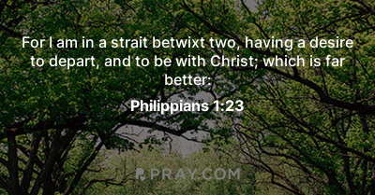

Slide 17
Philippians 1:21 – 26
Unbelievers would be without his compelling witness to the Resurrection. Believers would be bereft of his encouragement and inspiration (1:24).
Like any believer suffering great hardship, pain, and the lingering threat of death, Paul longed to be with Christ. But having weighed both prospects, he became convinced that the best path would be to remain for the sake of the “progress and joy” of the Philippians (1:25).
In this way, his life became an imitation of Christ, not by following Him in suffering and death, but by surrendering his own interests (to be with Christ) for the sake of others. In the end, of course, Paul didn’t have to choose life or death.

Slide 18
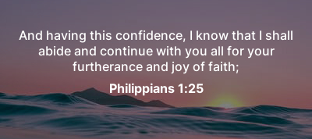

Slide 19
Philippians 1:21 – 26
This matter was chosen for him by the sovereign plan and purpose of God. This is why he wrote, “I know that I will remain and continue with you all” (1:25). Somehow it had been revealed to him that he would not, in fact, suffer the punishment of death but would be released to visit the Philippians yet again (1:26). How did he know this?
It’s possible that it had been revealed to him prophetically by the Holy Spirit, just as Peter’s imminent execution had been made clear by Christ (2Peter 1:14). It’s also possible that the Lord had allowed Paul to catch word through the Roman soldiers of the court’s disposition concerning his case. Paul’s confidence was that the dilemma would resolve itself with his release, whatever the source, it was well with his soul.

Slide 20
Philippians 1:27 – 30
²⁷Only let your conduct be worthy of the gospel of Christ, so that whether I come and see you or am absent, I may hear of your affairs, that you stand fast in one spirit, with one mind striving together for the faith of the gospel, ²⁸and not in any way terrified by your adversaries, which is to them a proof of perdition, but to you of salvation, and that from God. ²⁹For to you it has been granted on behalf of Christ, not only to believe in Him, but also to suffer for His sake, ³⁰having the same conflict which you saw in me and now hear is in me.

Slide 21
Philippians 1:27 – 30
Paul was convinced that he would ultimately be released to continue to serve Christ and minister to the churches, but the timing and manner of his release was uncertain. Though he longed to see the Philippians and had every intention of doing so, he knew that God was the only One whose opinion counted and whose itinerary would come to pass.
So, in case his visit was delayed, he wanted to hear that the Philippians were conducting themselves “in a manner worthy of the gospel of Christ (1:27). The Greek term translated “conduct yourselves,” has the sense of behaving as a proper citizen. Later Paul uses this word again when he tells the Philippians, “Our citizenship is in heaven” (3:20).

Slide 22
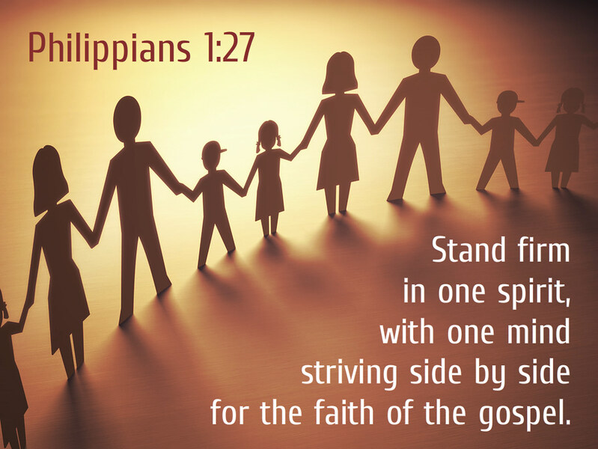

Slide 23
Philippians 1:27 – 30
Regardless of how Paul’s dilemma would ultimately work out, the responsibility of every Christian is the same: to live as citizens of heaven, not of this world system. What does it look like to live as a citizen of God’s heavenly kingdom while here on earth?
FIRST, we stay together in one spirit and mind (1:27). We are to live in unity and harmony with each other. We must avoid backbiting, gossiping, stirring up trouble, complaining, fighting, nagging, and all the other negative behaviors that break fellowship and bruise concord.
We’re to be the vaccine to discord and the antidote to schism, promoting peace and health in the body of Christ rather than debilitating it with poison.

Slide 24
Philippians 1:27 – 30
SECOND, we strive together for the faith of the gospel (1:27). The Greek term translated “strive together” comes from the root that gives us the word “athlete.” The term brings to mind the image of struggling side by side in a battle like gladiators or soldiers. It’s a blood-sweat-and-tears kind of term that implies courage, solidarity, and fighting to the finish.
THIRD, we stand together without becoming alarmed by the opposition (1:28). We should never go out looking for trouble, but when opponents step in our paths, we shouldn’t be startled. When they get in our faces, we shouldn’t flinch. When critics croon their taunts against the truth, we have no reason to shy away.

Slide 25
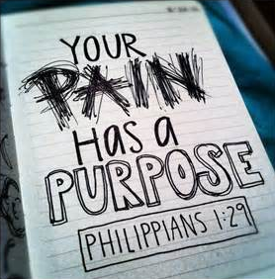

Slide 26
Philippians 1:27 – 30
THIRD, [CONT.] . . . Instead, we can stare them down in joyful calm. You want to see an opponent crumble? Respond to their angry attacks with joy.
Sadly, I’ve know many Christians who are scared to death every time a highbrow archaeologist digs up some artifact they claim disproves the Bible. Or they’re afraid when a smiling cultist knocks on their door shoving heretical propaganda in their faces. Or they almost jump out of the airplane when the person in the seat next to them asks if they actually believe the Bible they’re reading. But there’s no reason to be alarmed. Respond with calm confidence and disarming joy.

Slide 27
Philippians 1:27 – 30
When we stay together, strive together, and stand together, our united front will draw a clear line in the sand between the spiritual victors and the defeated foes of Christ.
SWINDOLL quotes F. F. Bruce > “The presence of opposition, Paul assures them, shows that they are on the right path in their active gospel witness. It is a token of salvation to them, as it is a token of perdition for their opponent . . . God is the author of the gospel: those who defend it may therefore expect deliverance and victory from him as surely as those who resist it may expect to incur his judgment.”

Slide 28
Philippians 1:27 – 30
Opposition—even the kind that results in persecution and suffering—reminds us, as it did for Paul, that we belong to King Jesus and are conducting ourselves as citizens of His kingdom.
Did you notice that when Paul’s dilemma was resolved (1:25-26), he gained complete clarity in how to move forward in confident joy? At first stuck between a rock and a hard place, as soon as he was out, the rock became his foundation and the hard place became his strength.
When we can embrace joy in the midst of all circumstance—even in the midst of seemingly unsolvable dilemmas—we find ourselves lifted above the fray, with a new heavenly perspective for continuing our earthly walk.

Slide 29
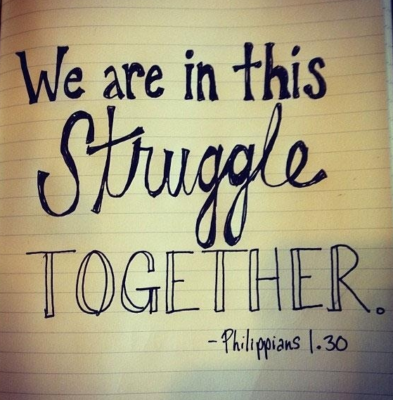

Slide 30



Slide 31
NEXT CLASS – 2 November 2022
Book of Philippians
Before next class, read the below verses in the NKJV and in one other versions of the Bible, i.e., NIV, NRSV, KJV, CEV, etc …
Chapter 2:1 – 11
“A Christlike Descent into Greatness”

